Slide 1
The Law of Wires: Electricity Transmission in Colorado
Mark D. Detsky
Dietze and Davis, P.C.
2060 Broadway Suite 400
Boulder, CO 80302
mdetsky@dietzedavis.com
3034471375

Slide 3
The Grid
WECC, ERCOT, Eastern Grid
Balancing areas – electricity cannot be stored
Redundancy = reliability
About 7 cents of a typical electric retail dollar – GEO
Regional Transmission Operators or Independent System Operators, Utilities, Merchant Transmission
Notes:
A balancing authority is the entity responsible for operating a control area. It matches generation with loads and maintains frequency within limits.

Slide 4
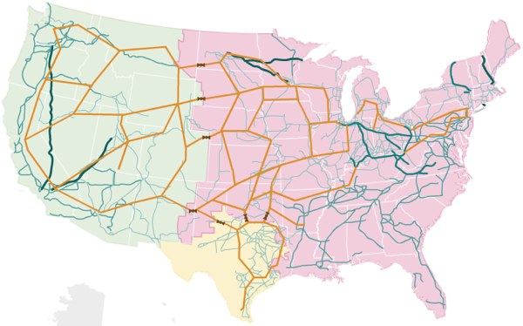
The US Electrical Grid

Slide 5
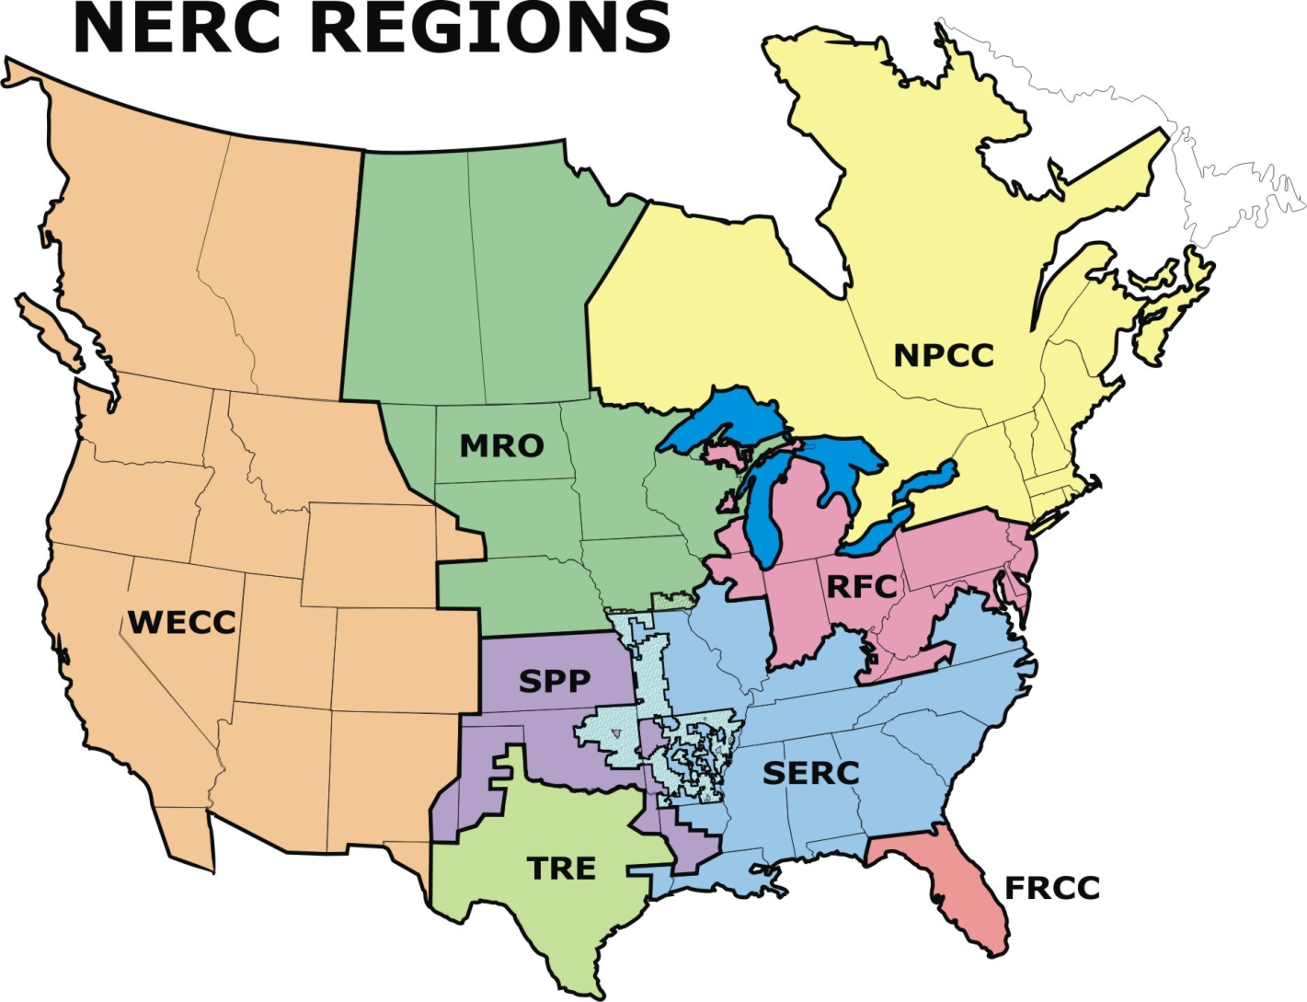
NERC (North American Electric Reliability Corporation)
Notes:
NERC is an international, independent, self-regulatory, not-for-profit organization, whose mission is to ensure the reliability of the bulk power system in North America. Bulk Power System Oversight:
NERC oversees reliability for a bulk power system that:
Provides electricity to 334 million people
Has a total electricity demand of 830 gigawatts (830,000 megawatts)
Has 211,000 miles or 340,000 km of high-voltage transmission line (230,000 volts and greater)
Represents more than $1 trillion (US) worth of assets.
Brief History:
NERC was founded in 1968 by the electric utility industry to develop and promote rules and protocols for the reliable operation of the bulk power electric transmission systems of North America. Click here for more on NERC’s history and evolution.

Slide 6
WestConnect
Planning Footprint
WECC
Subregional Planning Groups
Major Transmission Facilities
ColumbiaGrid
Northern Tier Transmission Group (NTTG)
Northwest Transmission Assessment Committee (NTAC) that are not part of ColumbiaGrid or NTTG
WestConnect (SWAT, CCPG & Sierra)
California ISO
California Transmission Planning Group that are not part of CAISO
Other Facilities
6

Slide 7
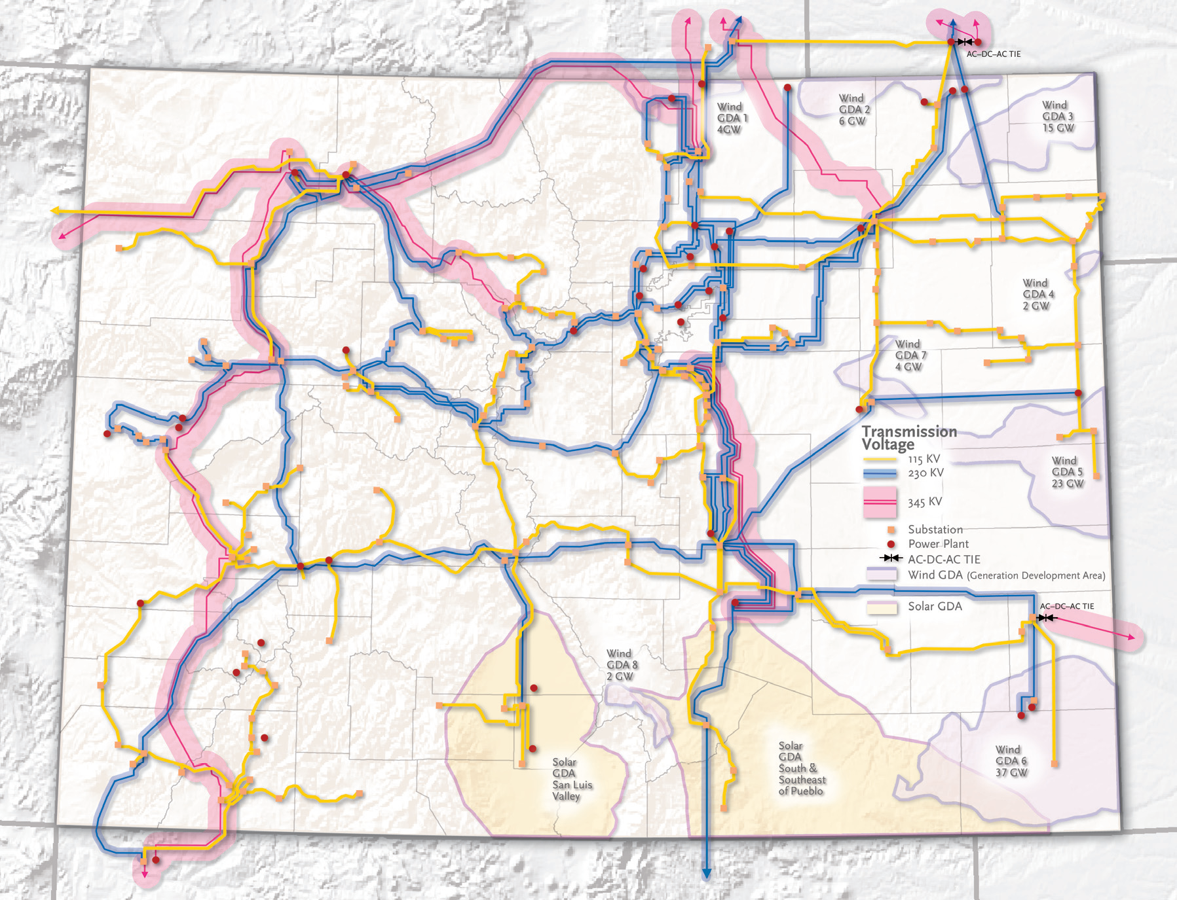

Slide 8
A Brief History
Rural Electrification
Bureau of Reclamation and the Western Area Power Administration
The rise of natural gas
Notes:
Western Area Power Administration markets and delivers reliable, cost-based hydroelectric power and related services within a 15-state region of the central and western U.S. We're one of four power marketing administrations within the U.S. Department of Energy whose role is to market and transmit electricity from multi-use water projects. Our transmission system carries electricity from 57 power plants operated by the Bureau of Reclamation, U.S. Army Corps of Engineers and the International Boundary and Water Commission. Together, these plants have an installed capacity of 10,395 megawatts.

Slide 9
Federal Jurisdiction
Interstate Transmission in Interstate Commerce
  All electrons are everywhere all the time
  Wholesale Transmission sec 201
  As opposed to distribution or retail (rates charged to consumers)
  Federal Power Act- Federal Energy Regulatory Commission (FERC) 16 USC 791 et seq
  Energy Policy Act of 1992 – expanded transmission authority
  Energy Policy Act of 2005 –Section 217 added to FPA
  transmission access
Notes:
92 – approve applications for transmission service
Case law – comparability standard utilities vs ipps
05 – FERC backstop authority

Slide 10
FERC - Transmission Restructuring
Transmission reform
Order Nos. 888, 889 and 890
  Openness in planning
  9 principles to be approved
  FERC only has jurisdiction over public utilities as defined in the FPA sec 201(e)
  INTERCONNECTION AND TRANSMISSION SERVICE
  connecting to the grid – beyond public utilities via reciprocity
  Order Nos. 2003 and 890
Notes:
Functional unbundling electricity generation and transmission
889 = OASIS + standards of conduct (chinese wall)
890 = 9 principles
Public = non-govt
Transmission rates – wheeling, postage stamp

Slide 12
Colorado
Public Utilities Commission
  Certificates of Public Convenience and Necessity
    Siting and cost recovery
  Transmission Planning
  Resource Planning
  Ratemaking (cost recovery and rate of return)
Local Siting – HB -1041
Municipal Utilities exempt, Co-ops have opted out
Notes:
No CPCN if in ordinary course of business
Local zoning applies with puc backstop authority
Transmission regulated as area within state interest under stanttue major faciliites of a public utility

Slide 13
Transmission Practice
Load and Resource matching, e.g. keeping the lights on. Resource planning
FERC 890 practices
Transmission Planning
Transmission Line Approval

Slide 14
Renewable Energy
Renewable Portfolio/Energy Standards
Colorado:
  40-2-124, C.R.S. (2004, 2006, 2010)
  Generation Development Areas
  Section 123 resources

Slide 15
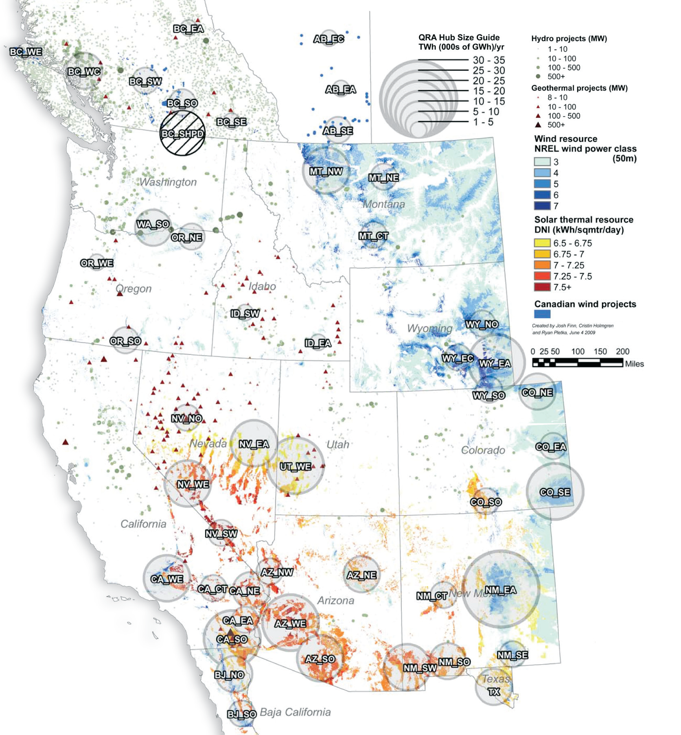
Notes:
Get to California
HPX
Sunzia
Zephyr

Slide 18
Environmental Concerns
CRCC
Nature Conservancy shortgrass prairie analysis
Smartlines vs “Extension Cords”
Fragmentation
Viewsheds
Noise and Electromagnic Current
Notes:
Avoid, minimize mitigate
PUC rules involve DOW

Slide 20
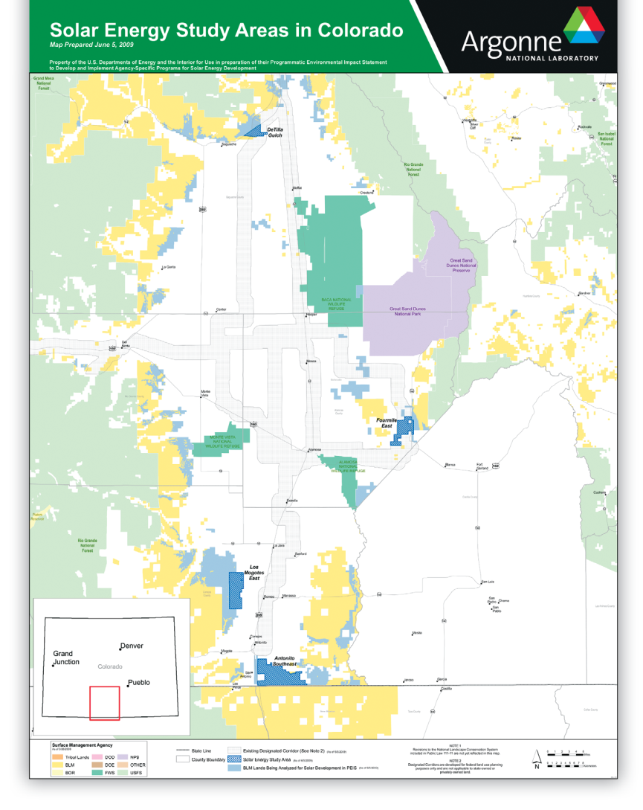
The San Luis Valley Case Study

Slide 21
Notes:
Western Area Power Administration markets and delivers reliable, cost-based hydroelectric power and related services within a 15-state region of the central and western U.S. We're one of four power marketing administrations within the U.S. Department of Energy whose role is to market and transmit electricity from multi-use water projects. Our transmission system carries electricity from 57 power plants operated by the Bureau of Reclamation, U.S. Army Corps of Engineers and the International Boundary and Water Commission. Together, these plants have an installed capacity of 10,395 megawatts.

Slide 22
News
National Corridors
ARRA – TIP
REDI Report
Smart Grid

